Slide 1
DSL Access Architectures and Protocols

Slide 2
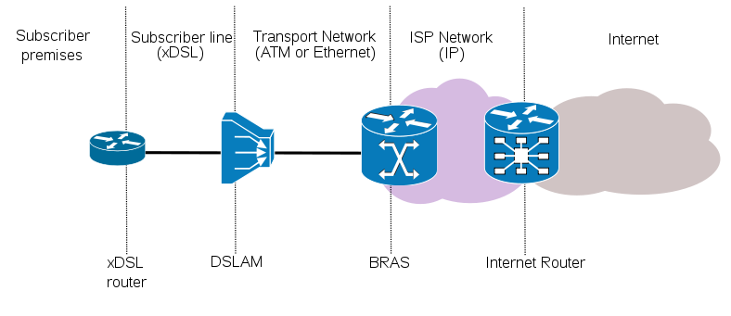
xDSL Architecture

Slide 3
Broadband Remote Access Server
The Broadband Remote Access Server (B-RAS) is a key component of DSL broadband access networks that serves as an aggregation point for subscriber traffic (IP, PPP and ATM) and provides session termination (PPPoX, RFC 1483) and subscriber management functions such as authentication, authorization, accounting (AAA), and IP address assignment.
For the aggregation Internet traffic, the BRAS serves as a L2TP Access Concentrator (LAC) tunneling multiple subscriber PPP sessions directly to an NSP. It also performs aggregation for terminated PPP sessions or routed IP session by placing them into IP VPNs or 802.1Q VLANs. The BRAS also supports ATM termination and aggregation functions.
Beyond aggregation, the BRAS is also the injection point for providing policy management and IP QoS in the Regional and Access Networks.

Slide 4
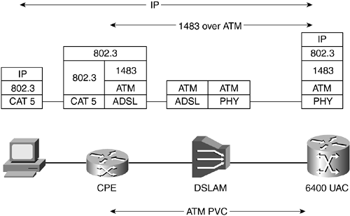
RFC 1483 Bridging Protocol Stack
Notes:
The CPE is a simple bridge that encapsulates Ethernet frames into ATM cells using the RFC 2684 bridging standard
The ATU-R acts as a half bridge, forwarding all MAC frames on the LAN side to the WAN interface.
802.3 MAC frames are encapsulated along with an LLC/SNAP or VC-MUX header into cells using AAL5 segmentation.
The LLC/SNAP header is used to identify the protocols encapsulated to the remote end.
RFC 1483 (and RFC 2684, which obsoletes it) describes two multiplexing methods for packets traveling over ATM (ATM being the typical network infrastructure employed on the other side of the DSLAM at the end of your phone line). One method, LLC encapsulation, can carry multiple protocols (IPv4, IPv6, ARP, IPX, Ethernet, etc) per ATM virtual circuit, while the other, VC multiplexing, uses a separate ATM VC for each protocol.
LLC encapsulation is more flexible, while VC multiplexing is more efficient. (In particular, since VC multiplexing relies on out-of-band setup to provide some of the information about the packets, the overhead in some — common — cases can be zero.)
The Logical Link Control (LLC) data communication protocol layer is the upper sub-layer of the Data Link Layer (which is itself layer 2, just above the Physical Layer) in the seven-layer OSI reference model. It provides multiplexing mechanisms that make it possible for several network protocols (IP, IPX) to coexist within a multipoint network and to be transported over the same network media, and can also provide flow control mechanisms.
The LLC sub-layer acts as an interface between the Media Access Control (MAC) sublayer and the network layer.
The Subnetwork Access Protocol (SNAP) is a mechanism for multiplexing, on networks using IEEE 802.2 LLC, more protocols than can be distinguished by the 8-bit 802.2 Service Access Point (SAP) fields. well as with non-IEEE 802 physical network layers such as FDDI that use 802.2 LLC.
SNAP is included in an extension of the 802.2 LLC header; iSNAP supports identifying protocols by Ethernet type field values; it also supports vendor-private protocol identifier spaces. It is used with IEEE 802.3, IEEE 802.4, IEEE 802.5, IEEE 802.11 and other IEEE 802 physical network layers, as
Bridge groups are defined by associating VCs with each other. Bridge groups can be defined in several ways.
Bridge members can communicate only with a network host, between each member and use IRB to route out of the bridge.
Bridge Group Virtual Interface (BVI) is a virtual interface that resides in the Cisco 827 and NRP. It acts as an interface between a bridge group and a routed interface. When configured for IRB, the BVI is assigned a number that corresponds to the bridge group that is used to associate the bridge group with the BVI. BVI is used as routed interface with network-layer attributes such as IP address, filtering, and so on. On BVI, routing is enabled on a per-protocol basis. BVI allows you to route a given protocol between routed interfaces and bridge groups.

Slide 5

Routed Bridge Encapsulation Protocol Stack
Notes:
RBE Overview
The ATU-R behaves like the routed-bridge interface that is connected to an Ethernet LAN.
For packets sending from the customer side, the destination IP address is examined, and the Ethernet header is skipped.
If the destination IP address is in the route cache, the packet is fast-switched to the outbound interface.
If the destination IP address is not the route cache, the packet is queued for process switching.
For packets destined for the customer devices, the destination IP address is examined first, and then the destination interface is determined from the IP routing table. To place a destination MAC address in the Ethernet header, the router checks the ARP table for that interface. If the MAC address is not found, the router generates an ARP request for the destination IP address and forwards the ARP request to the destination interface only. If an unnumbered interface is used and multiple subscribers are on the same subnet, the routed-bridge interface uses proxy ARP. All of these can be achieved without using a bridge group or BVI in the aggregation gateway and therefore are more scalable. Figure 8-6 illustrates the RBE protocol stack

Slide 6
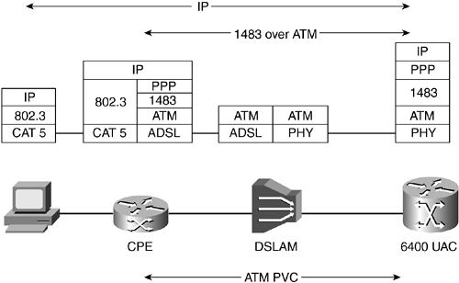
PPPoA
Notes:
the ATU-R acts as a router, and additionally provides DHCP and NAT services to the LAN side.
IP packets are encapsulated into a PPP frame and then are segmented into ATM cells through AAL5.
The PPP sessions initiated by the subscriber are terminated at the service provider that authenticates users, either using a local database on the router or through a RADIUS server.
After the user is authenticated, IPCP negotiation takes place, and then the IP address gets assigned to the CPE.
In networking, the Point-to-Point Protocol, or PPP, is a data link protocol commonly used in establishing a direct connection between two networking nodes. It can provide connection authentication, transmission encryption privacy, and compression.

Slide 7
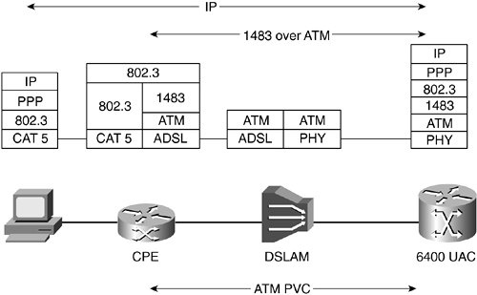
PPPOE
Notes:
the ATU-R is transparent to this function, bridging the MAC/PPP frames across the WAN interface.
The PPPoE feature allows a PPP session to be initiated on a simple client. The session is transported over the ATM link via encapsulated Ethernet-bridged frames.
The session can be terminated at either a local exchange carrier central office or an Internet service provider point of presence.
In the PPPoE architecture, the IP address allocation for the individual host running the PPPoE client is via IPCP negotiation.
Where the IP address is allocated from depends on the type of service the subscriber has subscribed to and where the PPP sessions are terminated.
.

Slide 8
Comparison
PPP based broadband service
  End user authentication to the network, forces the end user to authenticate to a radius server before being allowed access to the network
  Billing options, gives the provider the ability to offer different billing options, by time, by data, unlimited or by services purchased
  IP address conservation, a provider can limit the number of IPs a specific user can receive or can force a user off the connection at will
  Scalable, all authentication, authorization, and accounting can be handled for every user using existing Radius server
  Invisible to end user, both can be integrated in the Customer Premise Equipment CPE making the connection process invisible to the end user – though we do recommend they stay off the CPE but it is easily done and PPPoA is traditionally only on the CPE
  Service Selection, both can be used to offer multiple services and service selection
Negatives of PPPoA
  Only a single session per CPE can be established. In PPPoE we offer the ability to log in to multiple services or create multiple sessions all at the same time over the same line
  CPE setup and access, in general PPPoA must be configured on the CPE itself. Either the CPE must support PPPoE or an ATM network interface must be installed in the PC.ATM network interface cards are expensive and both can be difficult for an end user to configure. Once an end user has the ability to configure the CPE it opens up the problem for incorrect configurations making trouble shooting by the provider very difficult resulting in increased support costs What if the CPE was pre configured by the provider? This leads to increased fulfillment costs. The provider would then have to configure each CPE separately to enter the customer’s userid and password and loses the ability to batch process the CPE
Positives only found in PPPoE
  PPPoE offer the ability to log in to multiple services or create multiple sessions all at the same time over the same line. What do we mean by multiple services? How about a special account for a child that gives them G rated access only? How about a dedicated movie or music server?
Notes:
Instead of having the connection automatically occur when your computer boots (using DHCP for example to obtain an IP address), you would have to connect using PPPoE software like WinPoET, or maybe a router that will handle it for you. Once you are "connected" using the client, your connection will look / feel the same as your current connection. When you are finished, or when you've been idle for an undisclosed period of time, the client software may disconnect you and you will need to reconnect to gain access to the Internet again.
This is a difficult question to answer. The definition of the protocol points to a 5-10% decrease in bandwidth, as extra data will need to be sent down the line to handle the PPPoE signaling. There may be other penalties as well, derived from the server-side implementation.
If you look at this from a mathematical stand point PPPoE adds 8 bytes of header to the standard 1500 byte MTU packet. With this in mind you are only reducing speed by .3% (Yes .3 of one percent). So will you see a speed decrease, no, you probably won't.

